Slide 1


Security token access
Mt.Khademi
Brain bytes

Slide 2
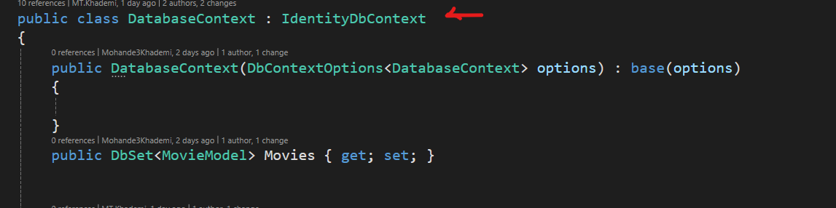
AUTHENTICATION [Identity]
1. Introduction ......
- What’s JWT ?????
- What’s Microsoft.AspNetCore.Identity.EntityFrameworkCore
- What’s Microsoft.AspNetCore.Authentication.JwtBearer
- System.IdentityModel.Tokens.Jwt
2. Refactor Old System
2.1. Change DbContext

Slide 3
AUTHENTICATION [Identity]
1. Introduction ......
- What’s JWT ? [Json web token]
- What’s Claim ? [some claims about this user – license driving]
- What’s Policy ? [ Is she/he can drive this car with License driving ? ]

Slide 4
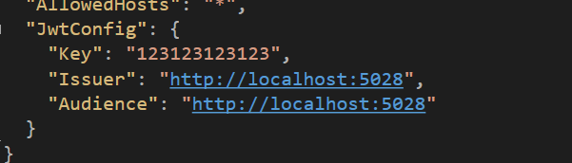
AUTHENTICATION [Identity]
3. Add settings for JWT token

Slide 5
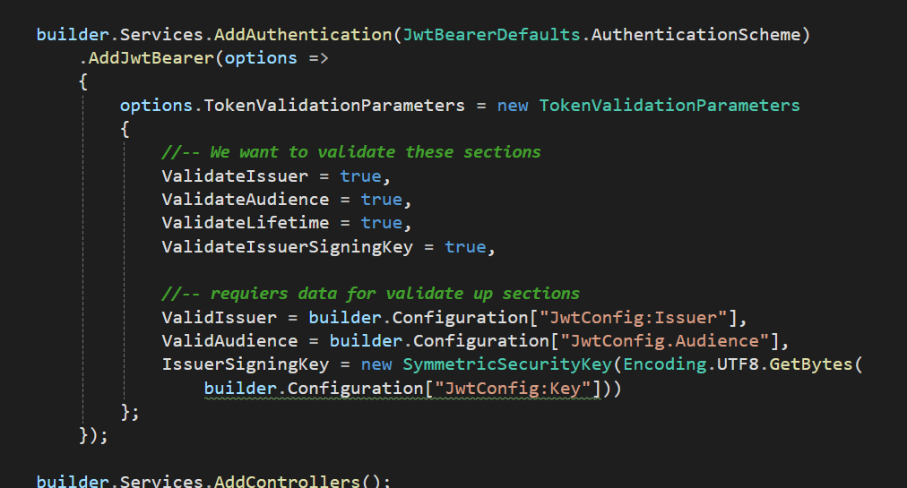
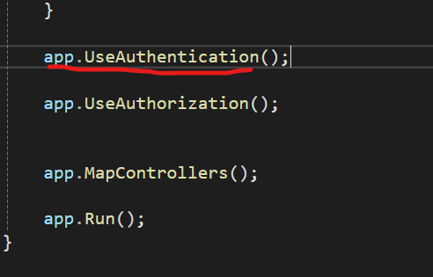
AUTHENTICATION [Identity]
3. Add services

Slide 6
AUTHENTICATION [Identity]
3. Add services

Slide 7
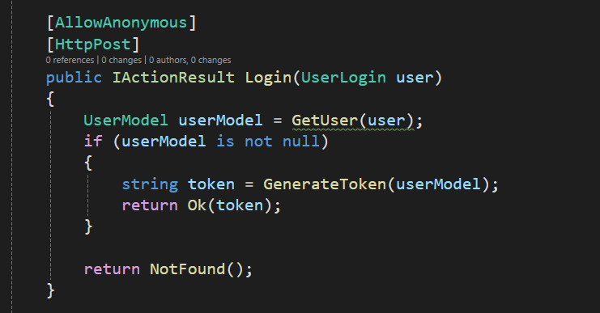
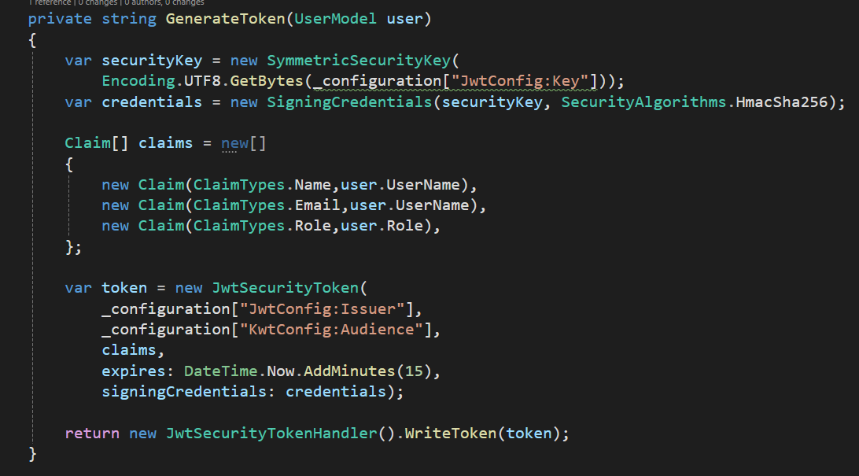
AUTHENTICATION [Identity]
3. Auth controller [LOGIN]

Slide 8
AUTHENTICATION [Identity]
3. Auth controller [LOGIN]

Slide 9
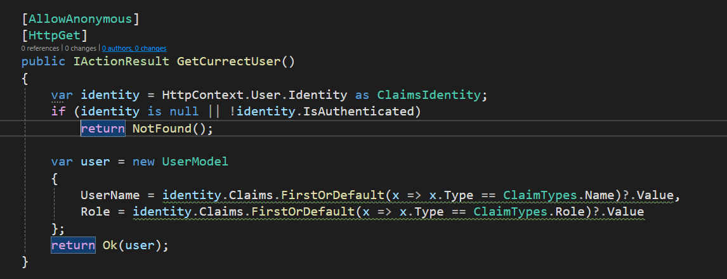
AUTHENTICATION [Identity]
3. Auth controller [GetCurrentUser]

Slide 10
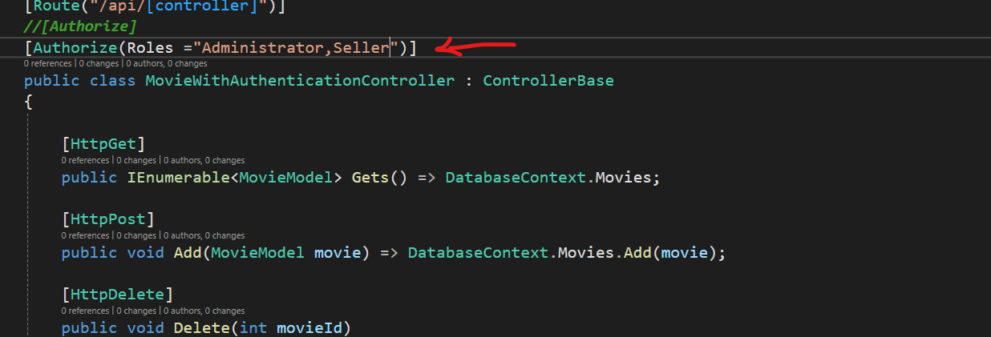
AUTHENTICATION [Identity]
.Add authorize base role in MovieController
اگر هیچ رولی وارد نکنیم همین که لاگین کرده باشه و اوکی باشه کافیه

